Slide 1
































ENGLISH YEAR 4
MODULE 1 - WHERE ARE YOU FROM?

Slide 2

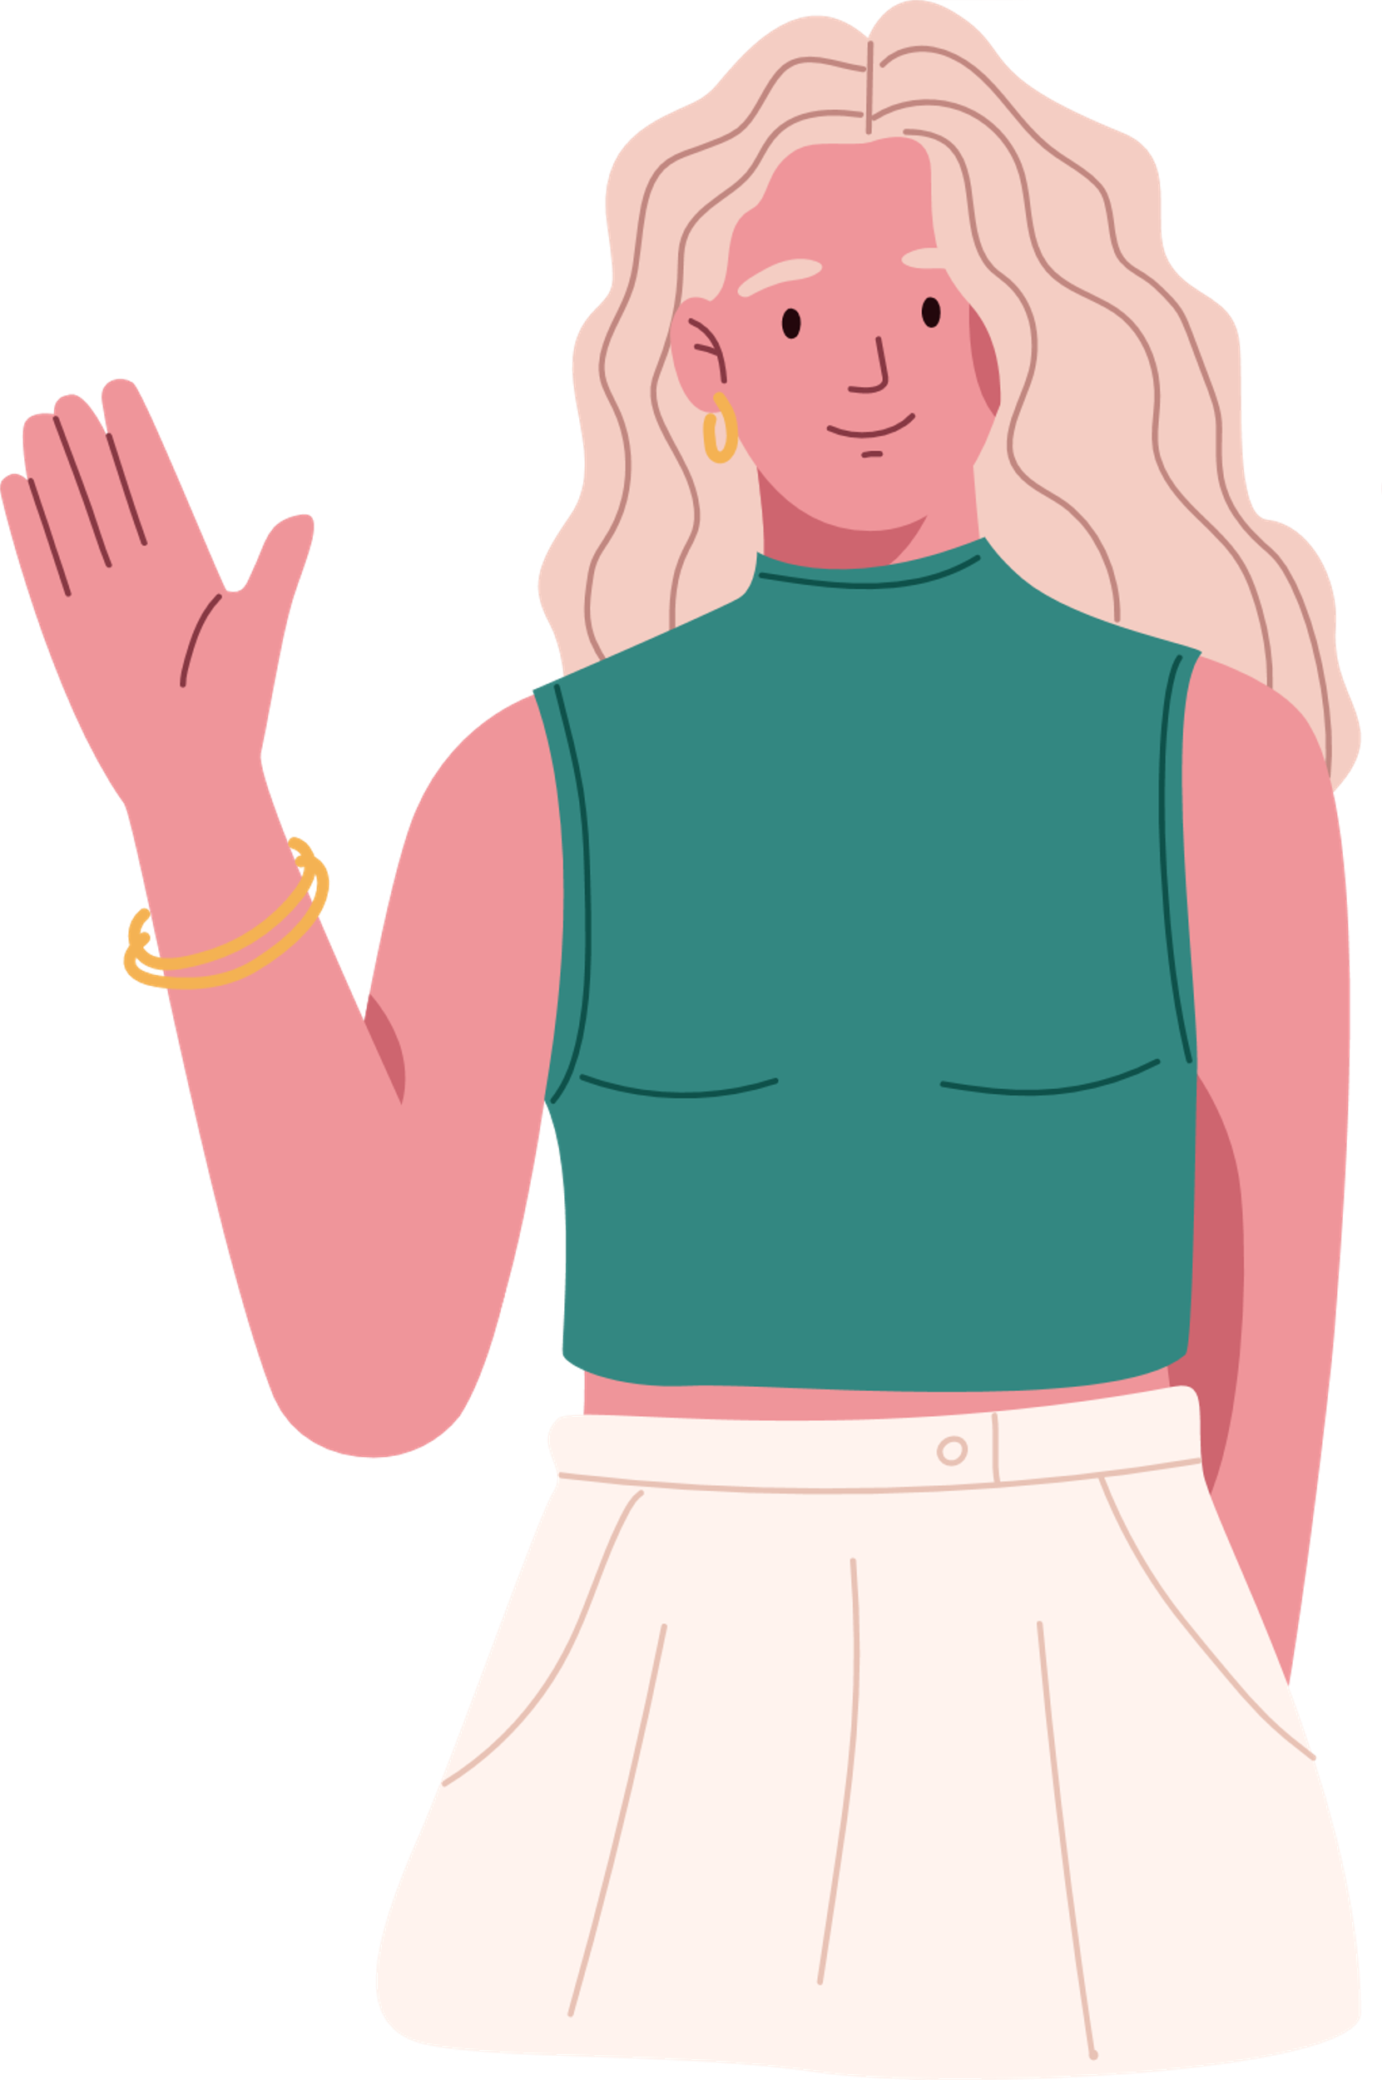

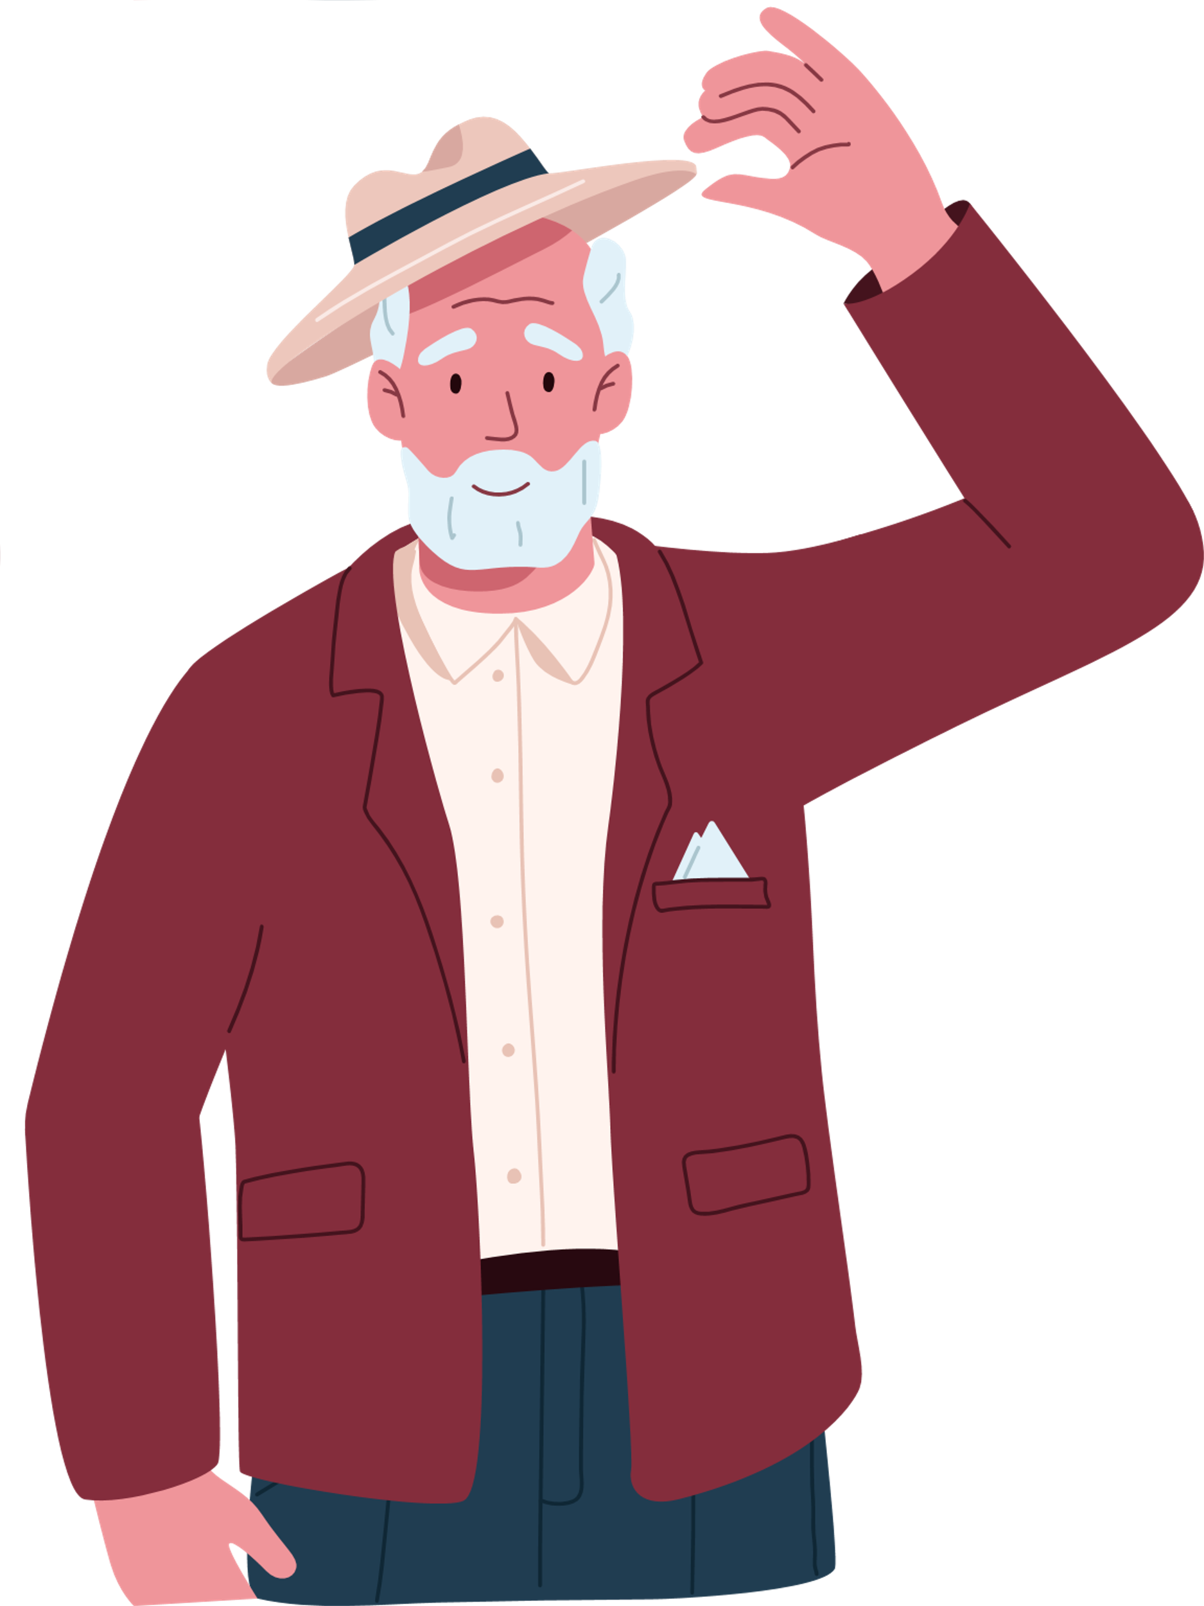
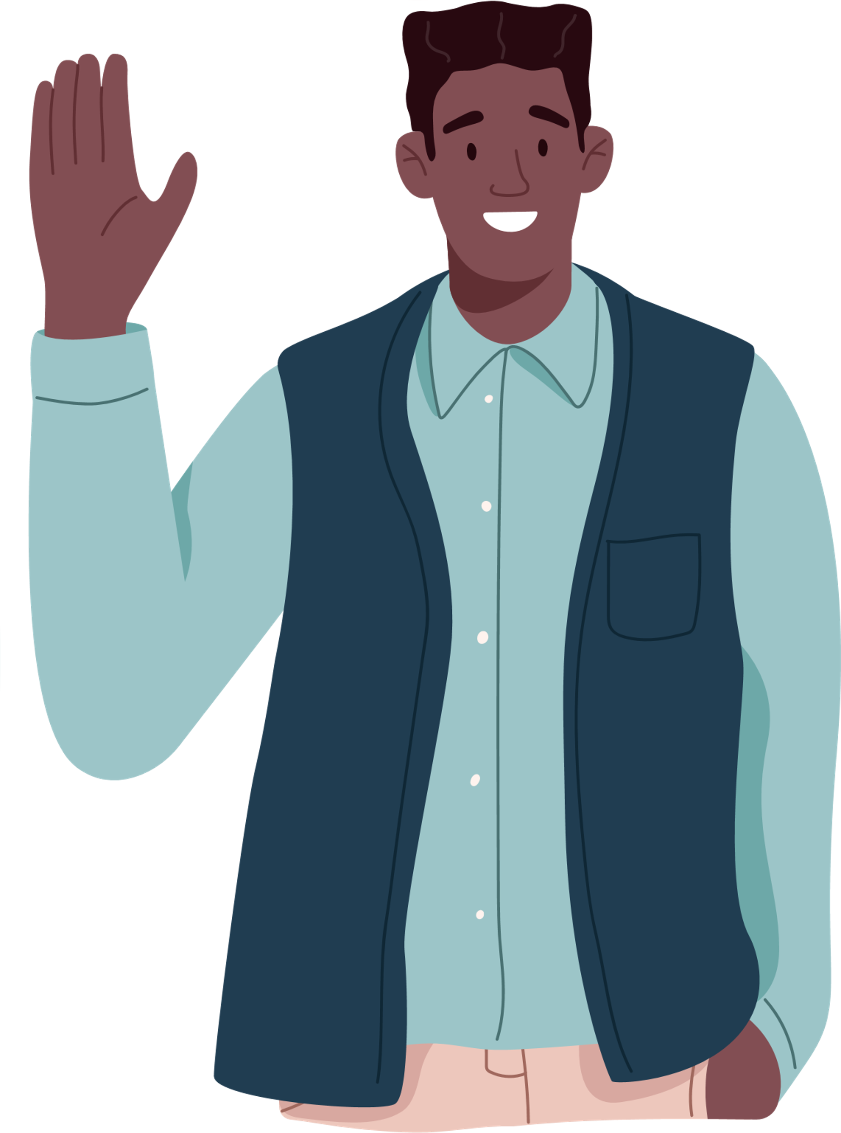

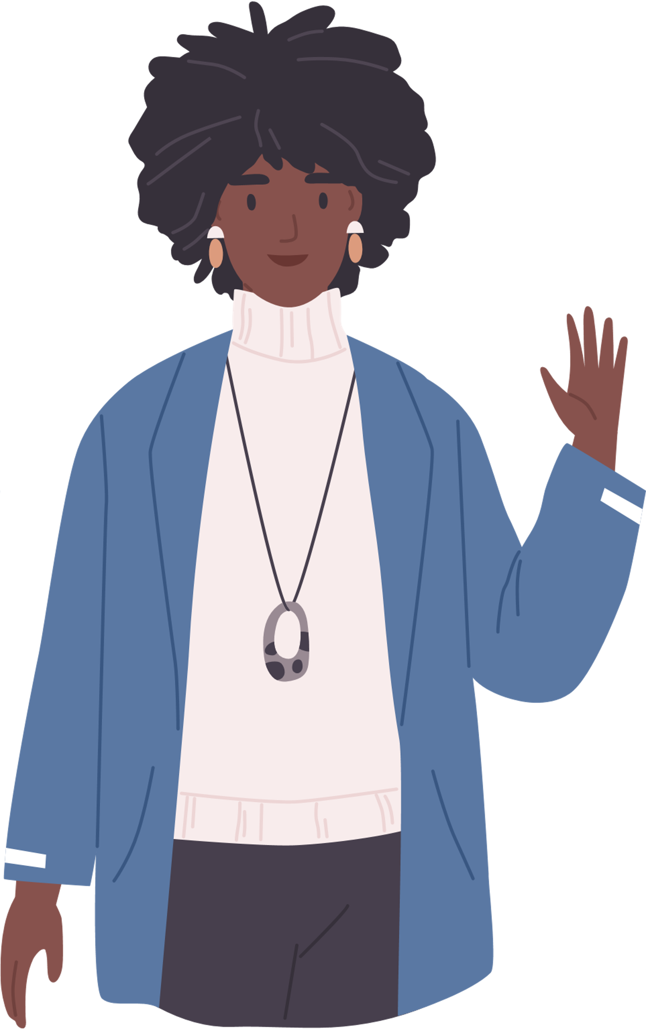
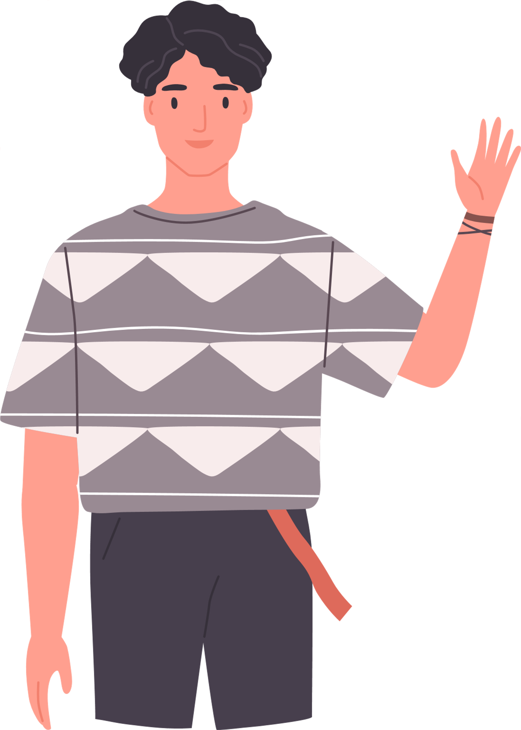
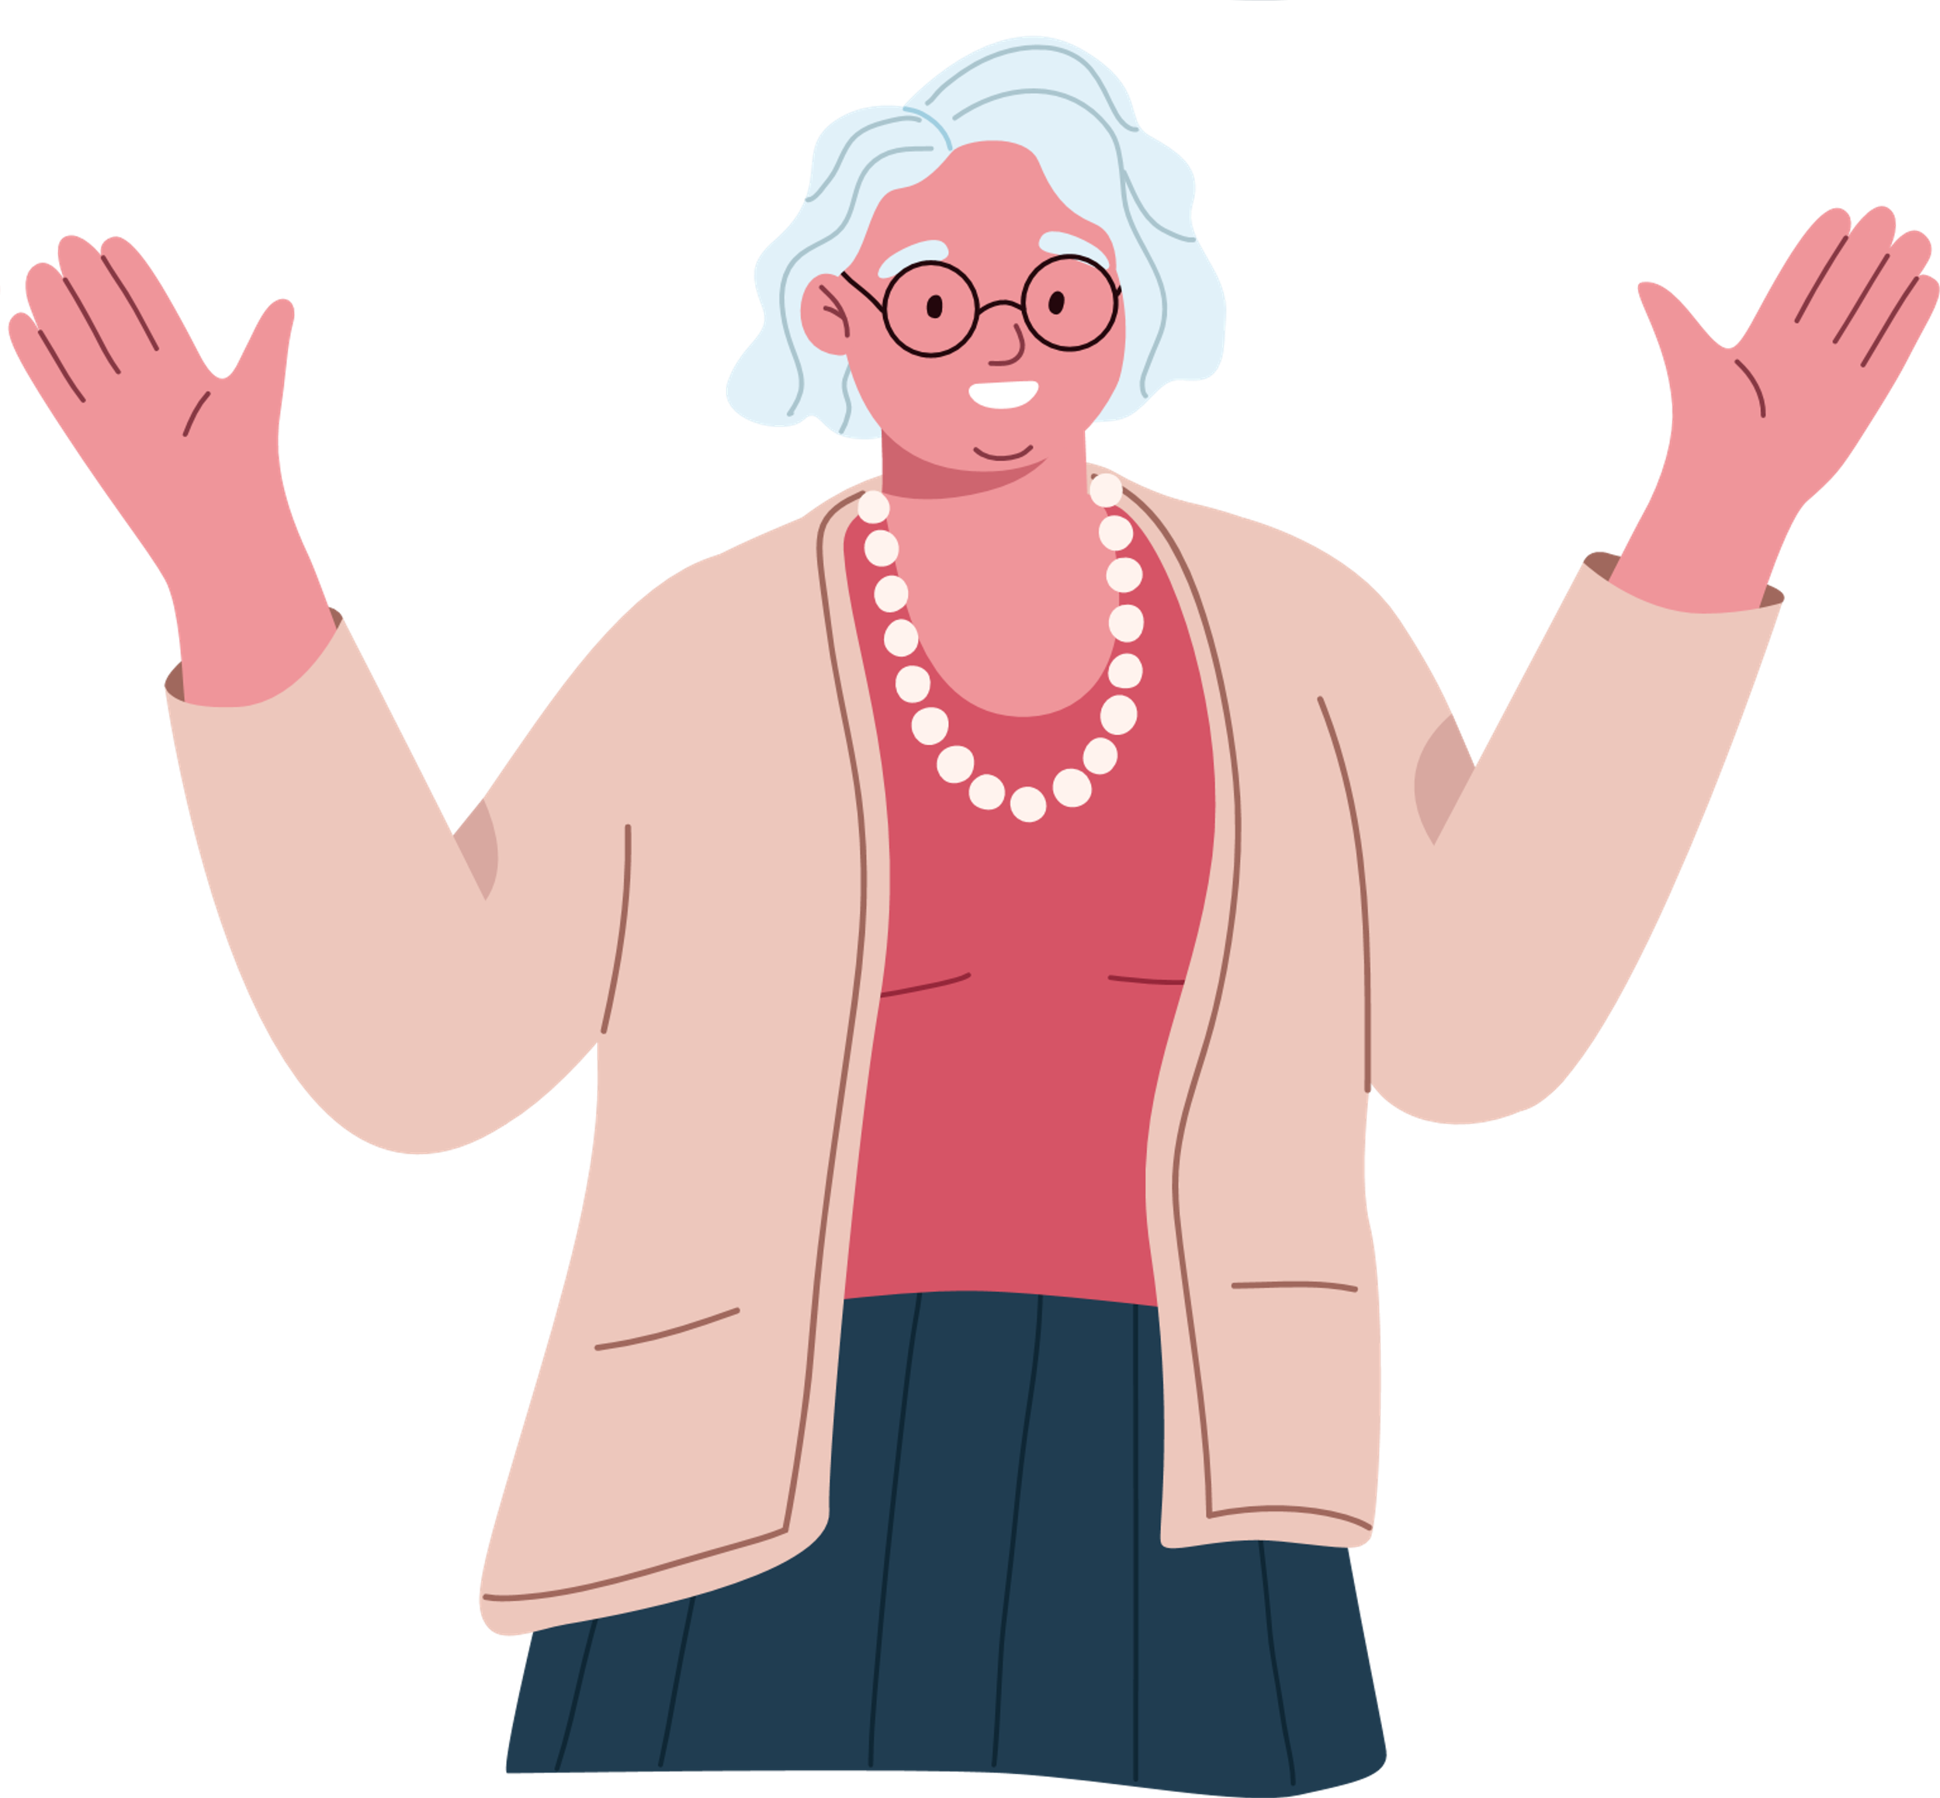

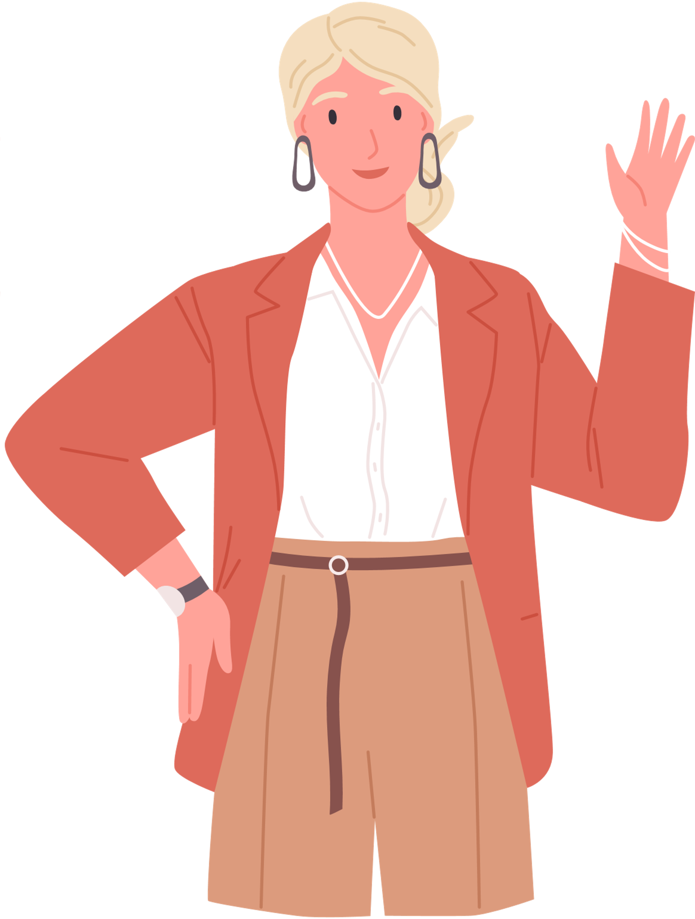

LEARNING OBJECTIVES
By the end of the lesson, pupils will be able to:
Understand with support, specific information and details of longer simple texts.
Recognise and reproduce with support, a wide range of target language phonemes.
Describe people, and objects using suitable statements.

Slide 3
WHAT ARE WE GOING TO LEARN TODAY?
Today, we are going to travel across the world and look at different countries and nationalities. Sit tight! Cause we are going on a journey but before that, have you ever been to any countries?

Slide 4


Hi! My name is Carla.
I'm from Italy. I'm Italian
Hi! I'm Salvador.
I'm from Brazil. I'm Brazilian

Slide 5
Hi! My name is Alexis.
I'm from Australia.
I'm Australian.
Hello! I'm Olivia.
I'm from the USA.
I'm American.

Slide 6
Hi! My name is Maria.
I'm from Mexico.
I'm Mexican.
Hi! I'm Felipe.
I'm from Argentina.
I'm Argentinian.

Slide 7


Hello! My name is Ashley.
I'm from the UK.
I'm British.
Hi! I'm Pierre.
I'm from France.
I'm French.

Slide 8

Hi! My name is Alice.
I'm from Canada.
I'm Canadian.
Hello! I'm Lesedi.
I'm from South Africa.
I'm South African.

Slide 9
Hello! I'm Luka.
I'm from Germany.
I'm German.
Hi! My name is Jing.
I'm from China.
I'm Chinese.

Slide 10
TIME TO REVIEW

Slide 11
Match the flags to the countries and tell the nationalities
BRAZIL
ITALY
THE USA
THE UK
AUSTRALIA
ARGENTINA
MEXICO
BRAZIL
FRANCE
CHINA
CANADA
GERMANY

Slide 12
WHAT ABOUT YOU?
WHERE ARE YOU FROM?
THANK YOU, STUDENTS!

